Slide 1

Customer Segmentation
Clustering (k-mean)
Réalisé par:
Dounia Drif

Slide 2
Méthodology
I

Slide 3
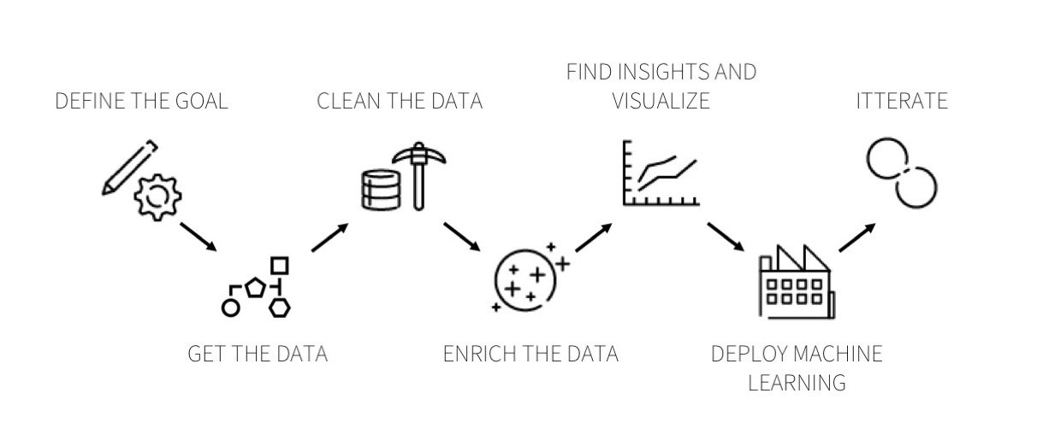

Slide 4
Step 1: Understand the problème
II

Slide 5
Customers Segementation :
Who are My customers ?
What are the catégories Of our Customers ?

Slide 6
Step 2: Get The Data
II

Slide 7
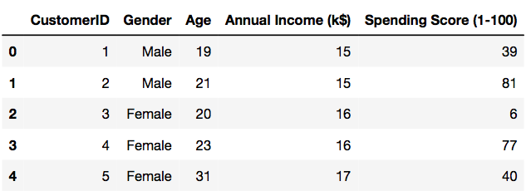
Mall Customer Segmentation Data
Open Data from kaggle
https://www.kaggle.com/vjchoudhary7/customer-segmentation-tutorial-in-python

Slide 8
Explore and Clean Your Data
II

Slide 9
dimension of data : (200, 5)
Columns : CustomersID , Gender , Age , Annuel Income(k$) , Spending Score (1-100)

Slide 10
 | CustomerID | Gender | Age | Annual Income (k$) | Spending Score (1-100)
column type | int64 | object | int64 | int64 | int64
null values (nb) | 0 | 0 | 0 | 0 | 0
null values (%) | 0 | 0 | 0 | 0 | 0

Slide 11
Step 4: Enrich &Visualise The Dataset
II

Slide 12
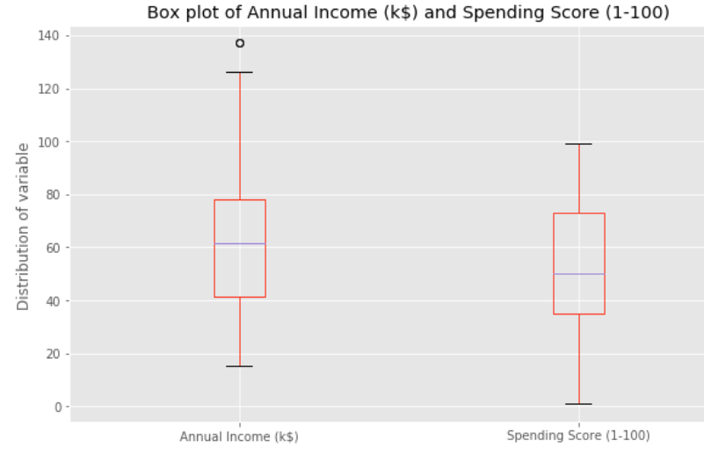

Slide 13
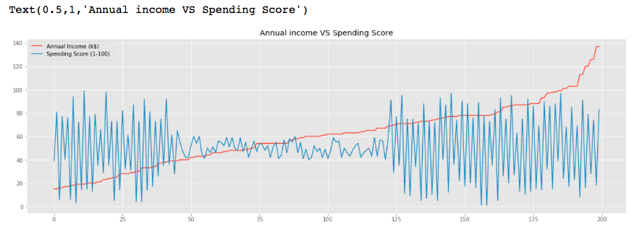

Slide 14
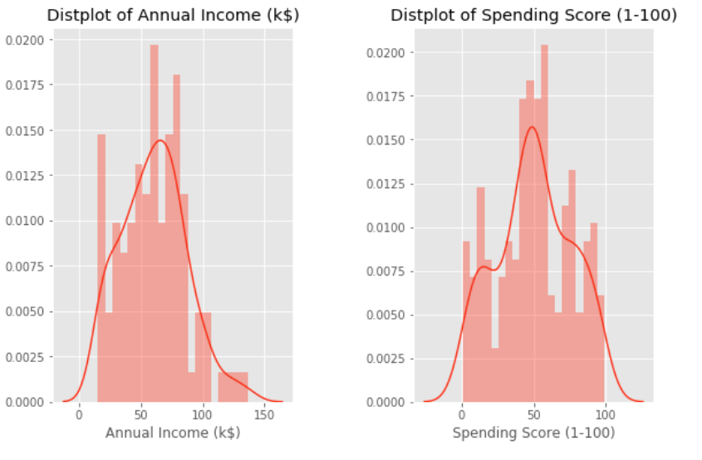

Slide 15
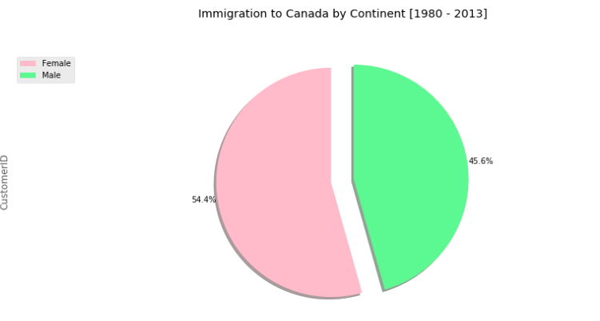

Slide 16
Step 5: Get Predictive
II

Slide 17
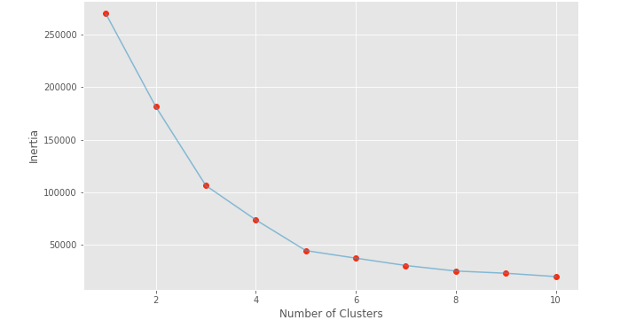
Segmentation using Annual Income and Spending Score

Slide 18
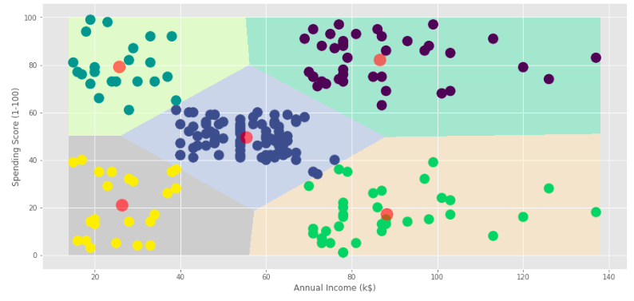

Slide 19
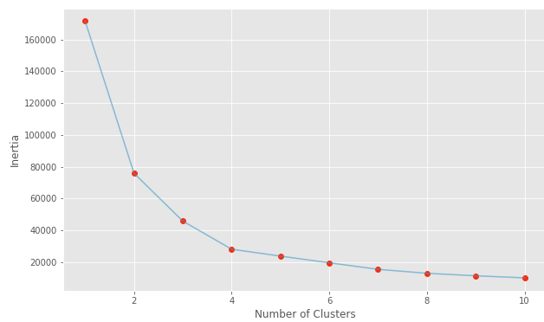
Segmentation using Age and Spending Score

Slide 20
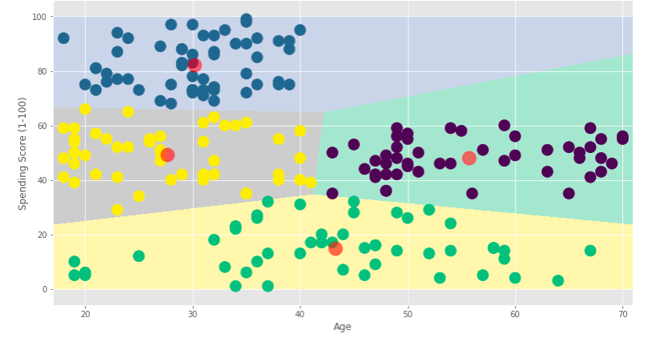

Slide 21
Conclusion

Slide 22
“A data scientist’s job is never really done, but that’s what makes working with data all the more fascinating! ”

